Slide 1


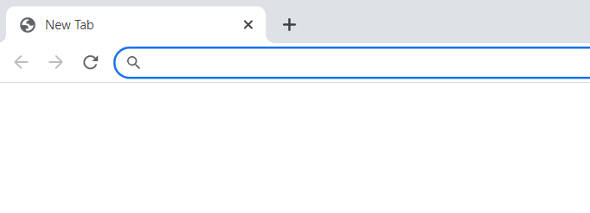

http://www.taurostarlearning.com
head
GET / HTTP/1.1
Host: www.taurostarlearning.com
head
IP : 52.172.194.244
Port: 80
Return IP: 103.56.227.36
HTTP/1.1 200 OK
Content-Type: text/html
Content-Length: 387
<html>
<body style="font-family: Arial;">
<h1>Hello World</h1>
...
...
</body>
</html>
body
Responding to IP: 103.56.227.36
body

